Slide 1



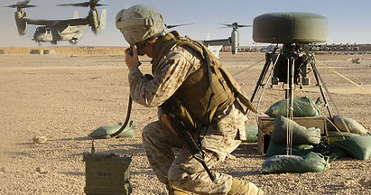
Defensive Programming, Assertions and Exceptions
Designing Error Steady Code
SoftUni Team
Technical Trainers
Software University
http://softuni.bg

Slide 2

Table of Contents
What is Defensive Programming?
How to Handle Errors?
Assertions and Debug.Assert(…)
Exceptions Handling Principles
Error Handling Strategies

Slide 3
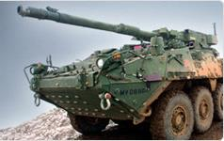
Defensive Programming
Using Assertions and Exceptions Correctly

Slide 4
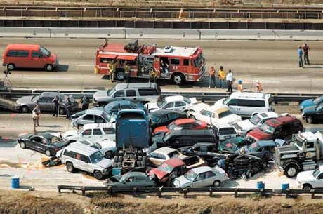
What is Defensive Programming?
Defensive programming is similar to defensive driving
You are never sure what other drivers will do
What to handle correctly?
Unusual execution flow, unusual situations, incorrect input and state
Expect incorrect input and handle it correctly

Slide 5
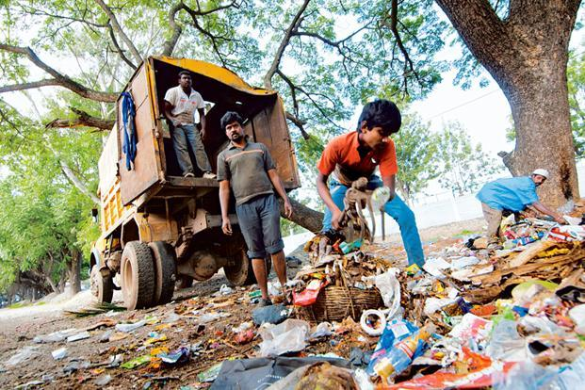

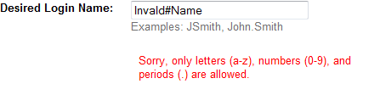
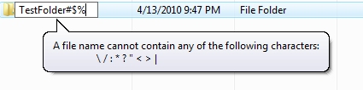
Protecting from Invalid Input
The "garbage in → garbage out" pattern is wrong!
Garbage in → exception out / error message out / no garbage allowed in / null value out
Data validation principle
Check the values of all data from external sources
From user, file, internet, DB, etc.

Slide 6
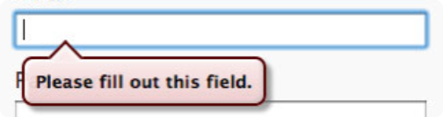
Protecting from Invalid Input (2)
Check the values of all routine input parameters
Decide how to handle bad input
Return a neutral value, e.g. null or undefined (JS / PHP)
Substitute with valid data, e.g. "Hi".substr(5,-3) → "" (JS)
Throw an exception, e.g. throw new ArgumentException(…)
Show an error message, e.g. balloon in the UI
Log and error message and stop the script, e.g. die() in PHP

Slide 7


Assertions
assert(len > 0)
Checking Preconditions and Postconditions

Slide 8
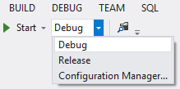
Assertions
Assertion – a check statement placed in the code, that must always be true at that moment of execution
Assertions are used during development
Removed in the release builds
Assertions check for bugs in the code
public double GetAverageStudentGrade()
{
Debug.Assert(studentGrades.Count > 0, "Student grades not initialized!");
return studentGrades.Average();
}

Slide 9
Assertions (2)
Use assertions for conditions that should never occur in practice
Failed assertion indicates a fatal error in the program → usually unrecoverable
Use assertions to document assumptions made in the code (preconditions & postconditions)
private Student GetRegisteredStudent(int id)
{
Debug.Assert(id > 0); // precondition check
Student student = registeredStudents[id];
Debug.Assert(student.IsRegistered); // postcondition check
}

Slide 10
Assertions (3)
Avoid putting executable code in assertions
PerformAction() won't be invoked in production. Better use:
Assertions should fail loudly
Assertion == fatal error → total crash
Assertions are supported in most languages: C#, Java, PHP, …
Debug.Assert(PerformAction(), "Could not perform action");
bool actionPerformed = PerformAction();
Debug.Assert(actionPerformed, "Could not perform action");

Slide 11
Assertions in Different Languages
Assertions in C#
Use Debug.Assert(condition, message)
Assertions in Java
Use the assert keyword in Java (see the official guidelines)
It throws AssertionError when an assertion fails
Assertions in PHP
Use the assert function (see the official documentation)
Assertions in JavaScript
No built-in assertions → write your own assert / use external library

Slide 12
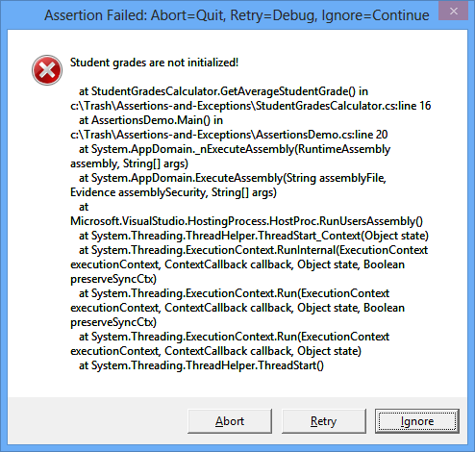
Assertions
Live Demo

Slide 13

Exceptions
Best Practices for Exception Handling

Slide 14
Exceptions
Exceptions provide a way to inform the caller about an error or exceptional events
Can be caught and processed by the callers
Methods can throw exceptions:
public void ReadInput(string input)
{
if (input == null)
{
throw new ArgumentNullException("Input string cannot be null."); }
…
}

Slide 15
Exceptions (2)
Use the try-catch statement to handle exceptions:
You can use multiple catch blocks to for different exception types
Unhandled exceptions propagate to the caller over the stack
void PlayNextTurn()
{
try
{
readInput(input);
…
}
catch (ArgumentException e)
{
Console.WriteLine("Invalid argument!");
}
}
Exception thrown here
The code here will not be executed

Slide 16
Exceptions (3)
Use finally block to execute code even if exception occurs:
Perfect place to perform cleanup for any resources allocated in the try block
void PlayNextTurn()
{
try
{
… }
finally
{
Console.WriteLine("Hello from finally!");
}
}
Exceptions can be eventually thrown here
This code will always be executed

Slide 17
Exceptions (4)
Use exceptions to notify the other parts of the program about errors / problematic situations
Errors that should not be ignored
Throw an exception only for conditions that are truly exceptional
Should I throw an exception when I check for user name and password? → better return false
Don't use exceptions as control flow mechanisms

Slide 18


Exceptions (5)
Throw exceptions at the right level of abstraction
class Employee
{
…
public TaxId
{ get { throw new JsonUnserializeException(…); }
}
class Employee
{
…
public TaxId
{ get { throw new EmployeeDataNotAvailable(…); }
}

Slide 19
Exceptions (6)
Use descriptive error messages
Incorrect example:
Example:
Avoid empty catch blocks
throw new Exception("Error!");
throw new ArgumentOutOfrangeException("The speed should be a number" + "between " + MinSpeed + " and " + MaxSpeed + ".");
try
{
…
}
catch (Exception ex) { }

Slide 20
Exceptions (7)
Always include the exception cause when throwing a new exception
try
{
WithdrawMoney(account, amount);
}
catch (DatabaseException dbex)
{
throw new WithdrawException(String.Format(
"Can not withdraw the amount {0} from account {1}",
amount, account), dbex);
}
We chain the original exception (the source of the problem)

Slide 21
Exceptions (8)
Catch only exceptions that you are capable to process correctly
Do not catch all exceptions!
Incorrect example:
What about OutOfMemoryException?
try
{
ReadSomeFile();
}
catch
{
Console.WriteLine("File not found!");
}

Slide 22
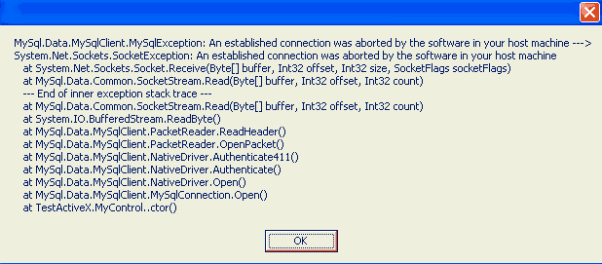
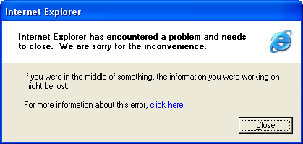
Exceptions (9)
Have an exception handling strategy for all unexpected / unhandled exceptions:
Consider logging (e.g. Log4Net / Log4J / error_log)
Display to the end users only messages that they could understand
or

Slide 23

Exceptions
Live Demo
Decompiling using ILSpy

Slide 24



Error Handling Strategies
Assertions vs. Exceptions vs. Other Techniques

Slide 25
Error Handling Techniques
How to handle errors that you expect to occur?
Throw an exception (in OOP)
Return a neutral value, e.g. -1 in IndexOf(…)
Substitute the next piece of valid data (e.g. file)
Return the same answer as the previous time
Substitute the closest legal value
Return an error code (in old languages / APIs)
Display an error message in the UI
Call method / log a warning message
Crash / shutdown / reboot

Slide 26
Assertions vs. Exceptions
Exceptions are notifications about error condition or unusual event
Inform the caller about error or exceptional event
Can be caught and application can continue working
Assertions are fatal errors
Assertions always indicate bugs in the code
Can not be caught and processed
Application can't continue in case of failed assertion
When in doubt → throw an exception

Slide 27
Assertions in C, C++, C# and JavaScript
Assertions in C# are rarely used
In C# prefer throwing an exception when the input data / internal object state are invalid
Exceptions are used in C# and Java instead of preconditions checking
Prefer using unit testing for testing the code instead of postconditions checking
Assertions are popular in C / C++
Where exceptions & unit testing are not so popular
In JS there are no built-in assertion mechanism

Slide 28
Error Handling Strategy
Choose your error handling strategy and follow it consistently
Assertions / exceptions / error codes / other
In C#, .NET, Java and OOP prefer using exceptions
Assertions are rarely used, only as additional checks for fatal error
Throw an exception for incorrect input / incorrect object state / invalid operation
In JavaScript use exceptions: try-catch-finally
In non-OOP languages use error codes / return undefined
In PHP: use OOP + exceptions or write in procedural style

Slide 29
Robustness vs. Correctness
How will you handle an error while calculating single pixel color in a computer game?
How will you handle error in financial software? Can you afford to lose money?
Correctness == never returning wrong result
Try to achieve correctness as a primary goal
Robustness == always trying to do something that will allow the software to keep running
Use as last resort, for non-critical errors

Slide 30
Assertions vs. Exceptions
public string Substring(string str, int startIndex, int length)
{
if (str == null)
{
throw new NullReferenceException("Str is null.");
}
if (startIndex >= str.Length)
{
throw new ArgumentException("Invalid startIndex:" + startIndex);
}
if (startIndex + count > str.Length)
{
throw new ArgumentException("Invalid length:" + length);
}
…
Debug.Assert(result.Length == length);
}
Check the input and preconditions
Perform the method's main logic
Check the postconditions

Slide 31




Error Barricades
Barricade your program to stop the damage caused by incorrect data
Consider same approach for class design
Public methods → validate the data
Private methods → assume the data is safe
Consider using exceptions for public methods and assertions for private
public methods / functions
safe data
private methods / functions

Slide 32
Being Defensive About Defensive Programming
Too much defensive programming is not good
Strive for balance
How much defensive programming to leave in production code?
Remove the code that results in hard crashes
Leave in code that checks for important errors
Log errors for your technical support personnel
See that the error messages you show are user-friendly

Slide 33
Defensive Programming, Assertions and Exceptions
https://softuni.bg/courses/high-quality-code/

Slide 34

License
This course (slides, examples, demos, videos, homework, etc.) is licensed under the "Creative Commons Attribution-NonCommercial-ShareAlike 4.0 International" license
Attribution: this work may contain portions from
"High Quality Code" course by Telerik Academy under CC-BY-NC-SA license

Slide 35
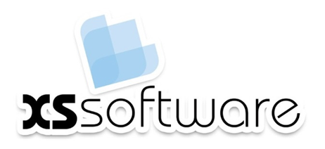






SoftUni Diamond Partners

Slide 36





Free Trainings @ Software University
Software University Foundation – softuni.org
Software University – High-Quality Education, Profession and Job for Software Developers
softuni.bg
Software University @ Facebook
facebook.com/SoftwareUniversity
Software University @ YouTube
youtube.com/SoftwareUniversity
Software University Forums – forum.softuni.bg

